Slide 1
KEEN Year Review
Kyle McMahon
KEEN Statewide Coordinator

Slide 2
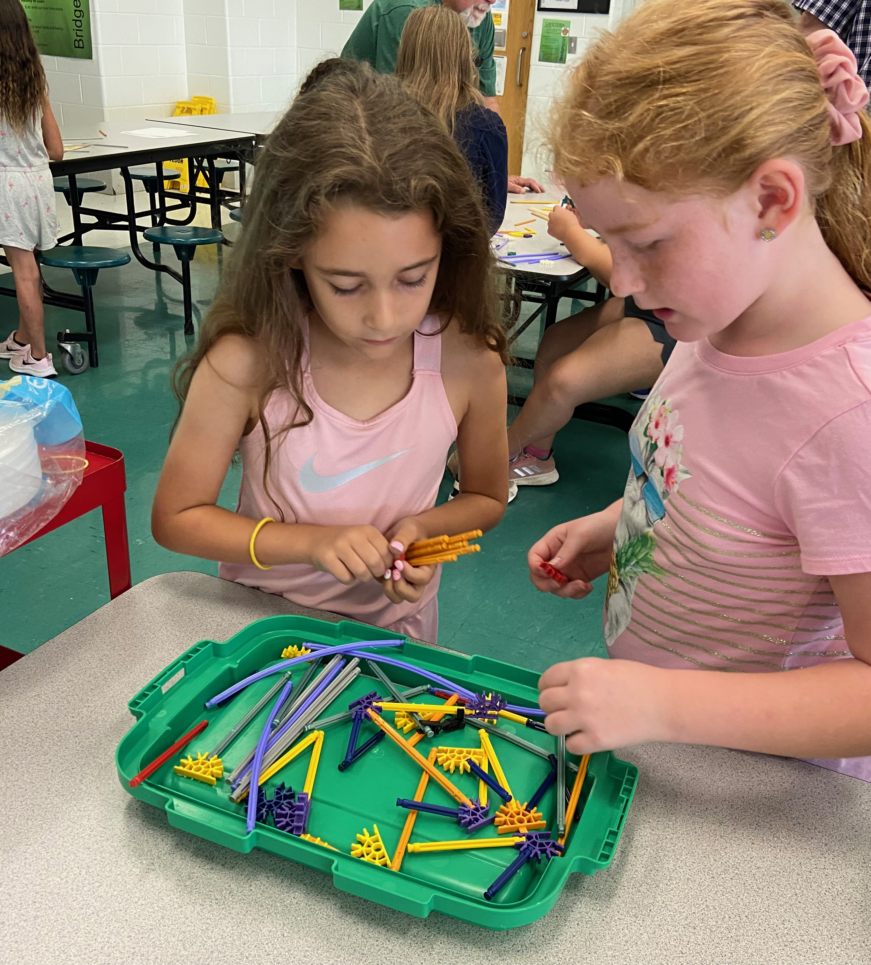
KEEN – KYTC Engineering Outreach
Community Outreach
Hands-on classroom presentations expose elementary & middle school children to engineering at a young age
High school Career Fairs and activities
KEEN promotes KYTC programs:
Civil Engineering Scholarship
Civil Engineering Technology Scholarship
Construction Management Scholarship
Minority Internship Program
Transportation Mechanic Apprenticeship Program

Slide 3
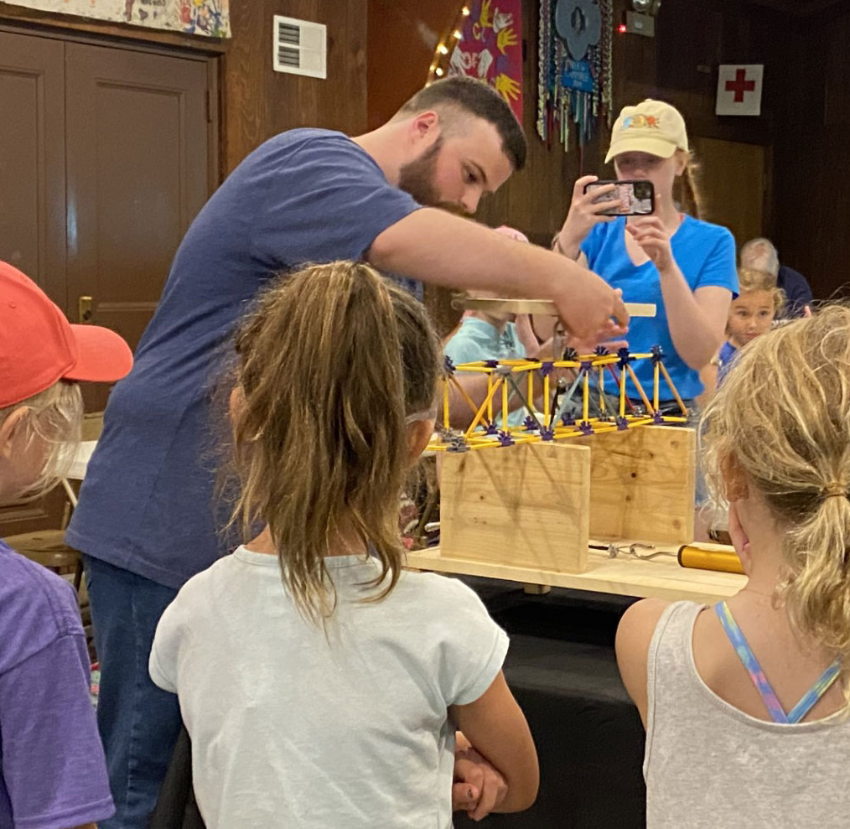
IMPACT OF KEEN ON MEMBERS
Camps and activities

Slide 4
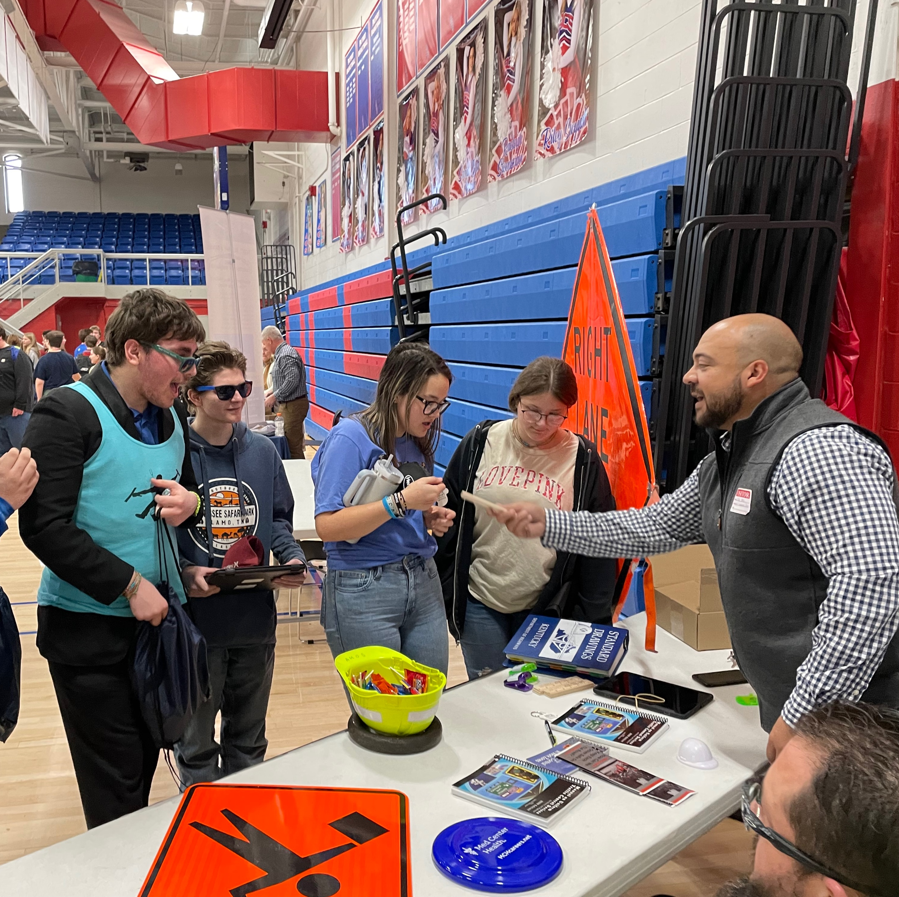
Career Fairs

Slide 5
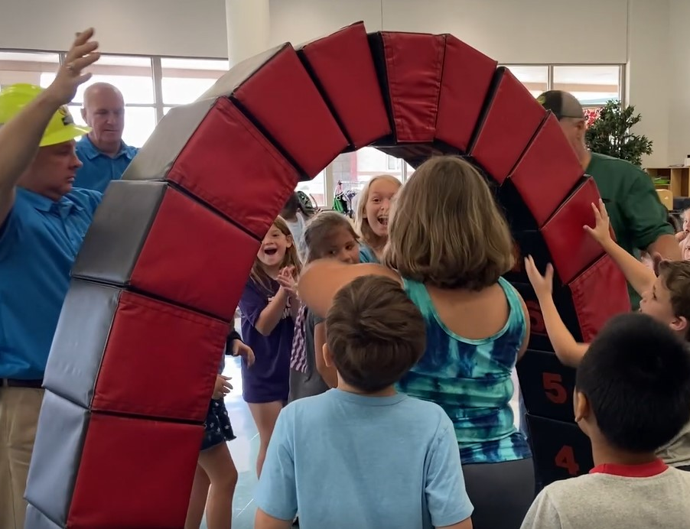
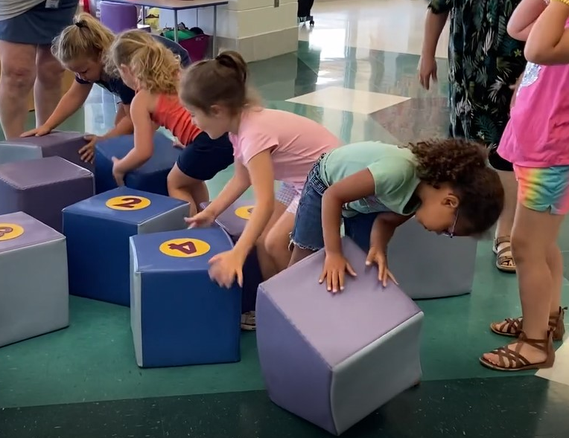
HANDS-ON ACTIVITIES

Slide 6
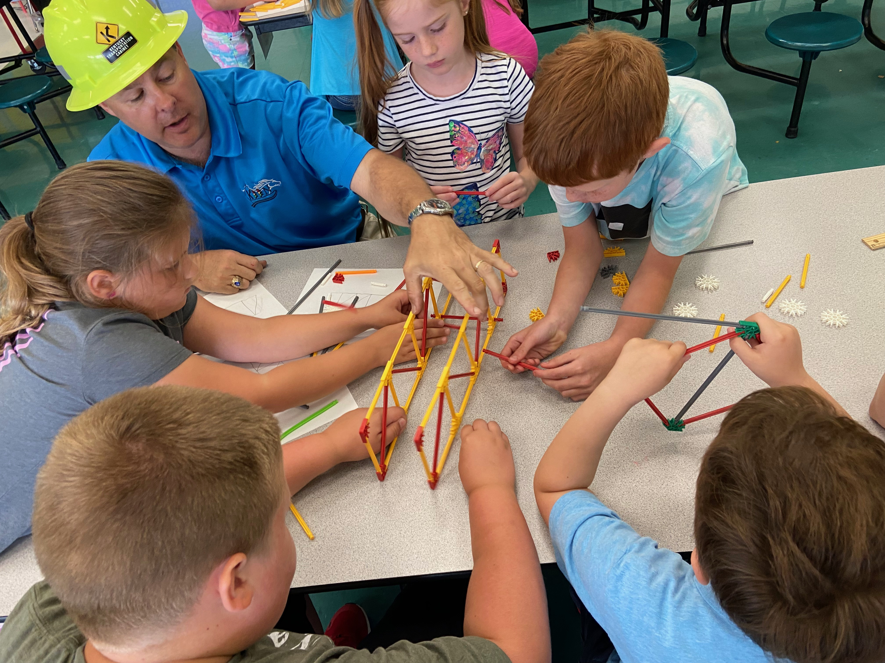
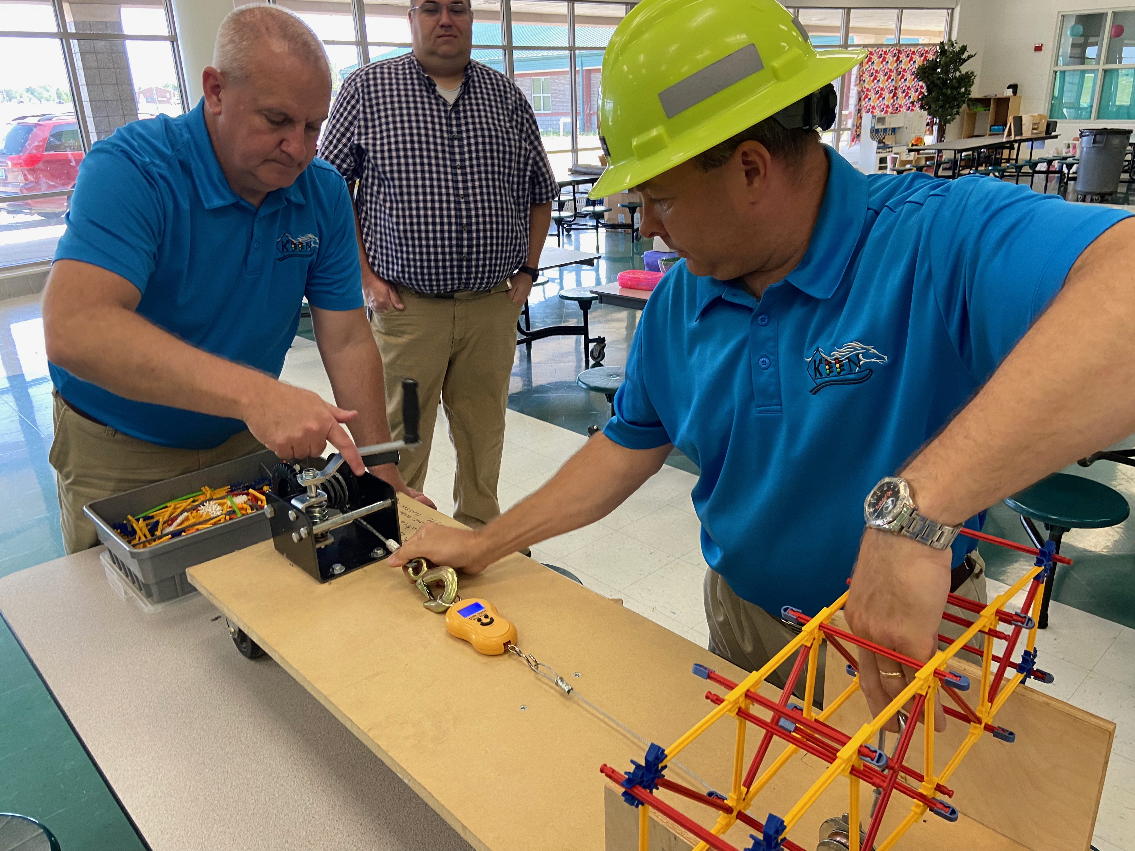
HANDS-ON ACTIVITIES

Slide 7
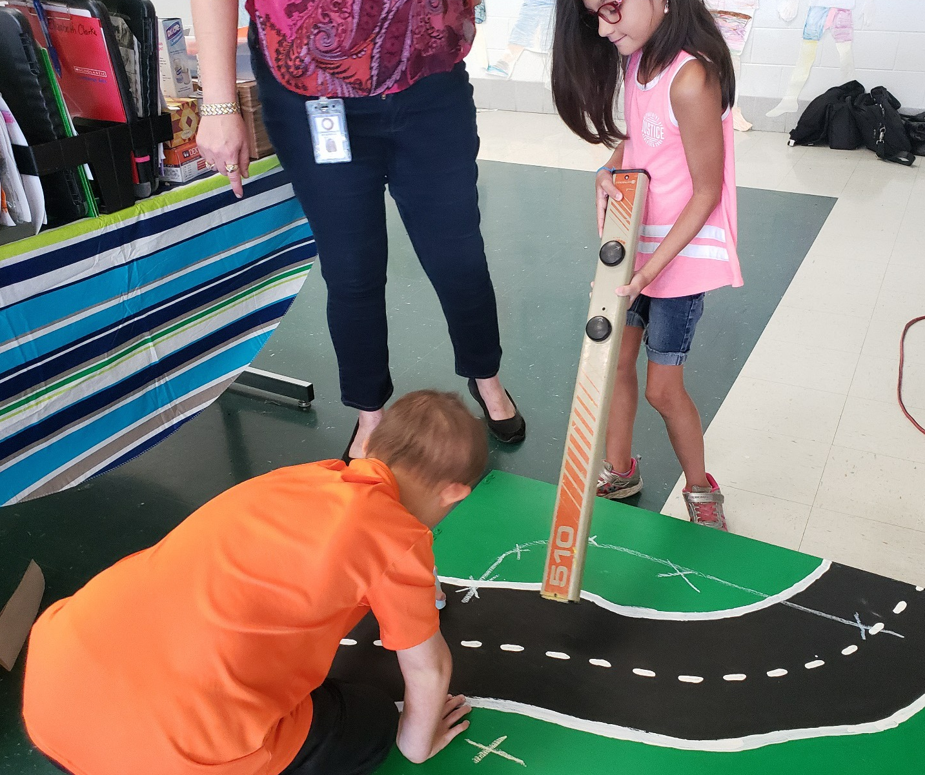
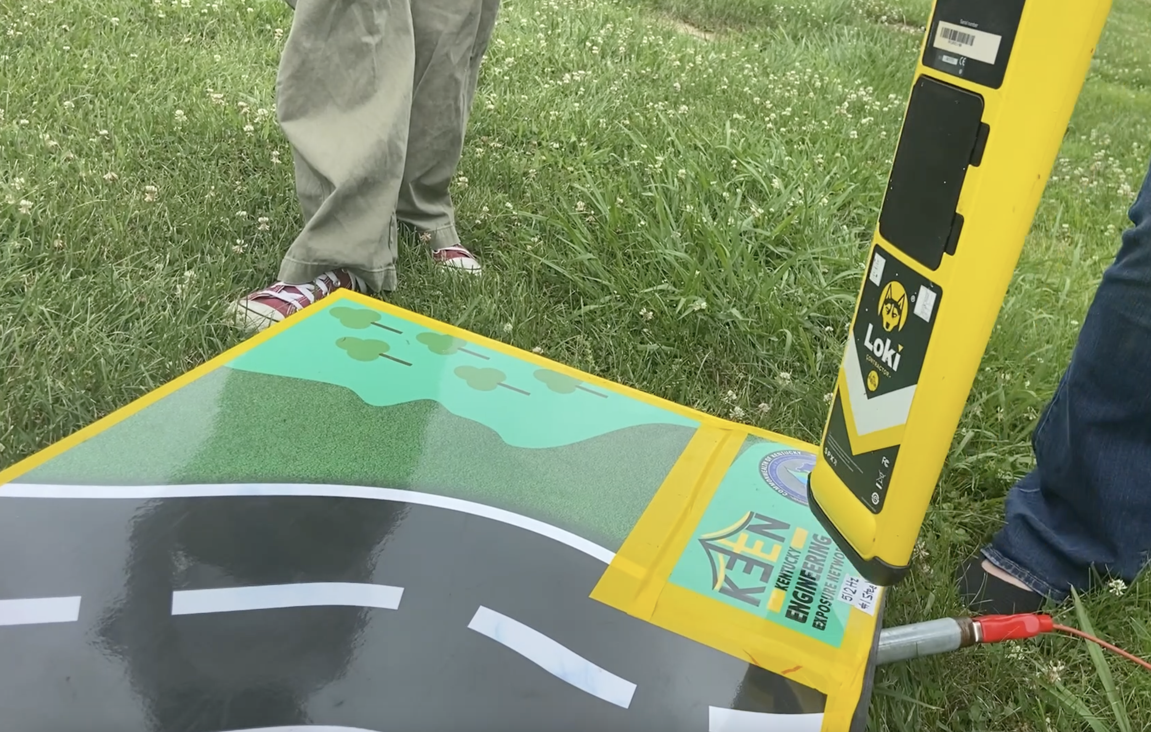
HANDS-ON ACTIVITIES

Slide 8
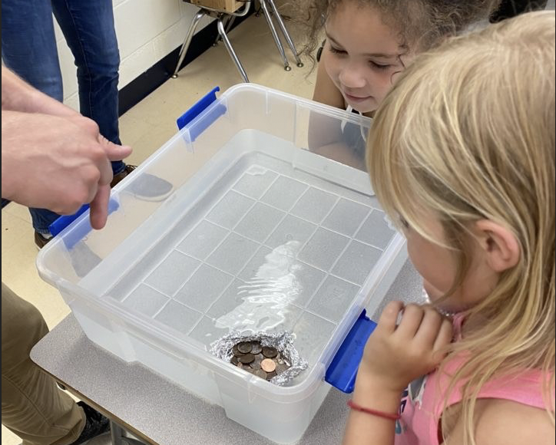
HANDS-ON ACTIVITIES

Slide 9
CLASSROOM ACTIVITIES

Slide 10
BUILDING ON GROWTH

Slide 11
THREE SCHOLARSHIPS
New careers or transitions
Construction Management Scholarship Program over $59,000
Civil Engineering Scholarship Program over $59,000.
Civil Engineering Technology Scholarship Program up to $14,800 ($3,700 per semester)
Paid internships while going to school and a job with KYTC when you finish your education.
Deadline to apply for this scholarship is February 1

Slide 12
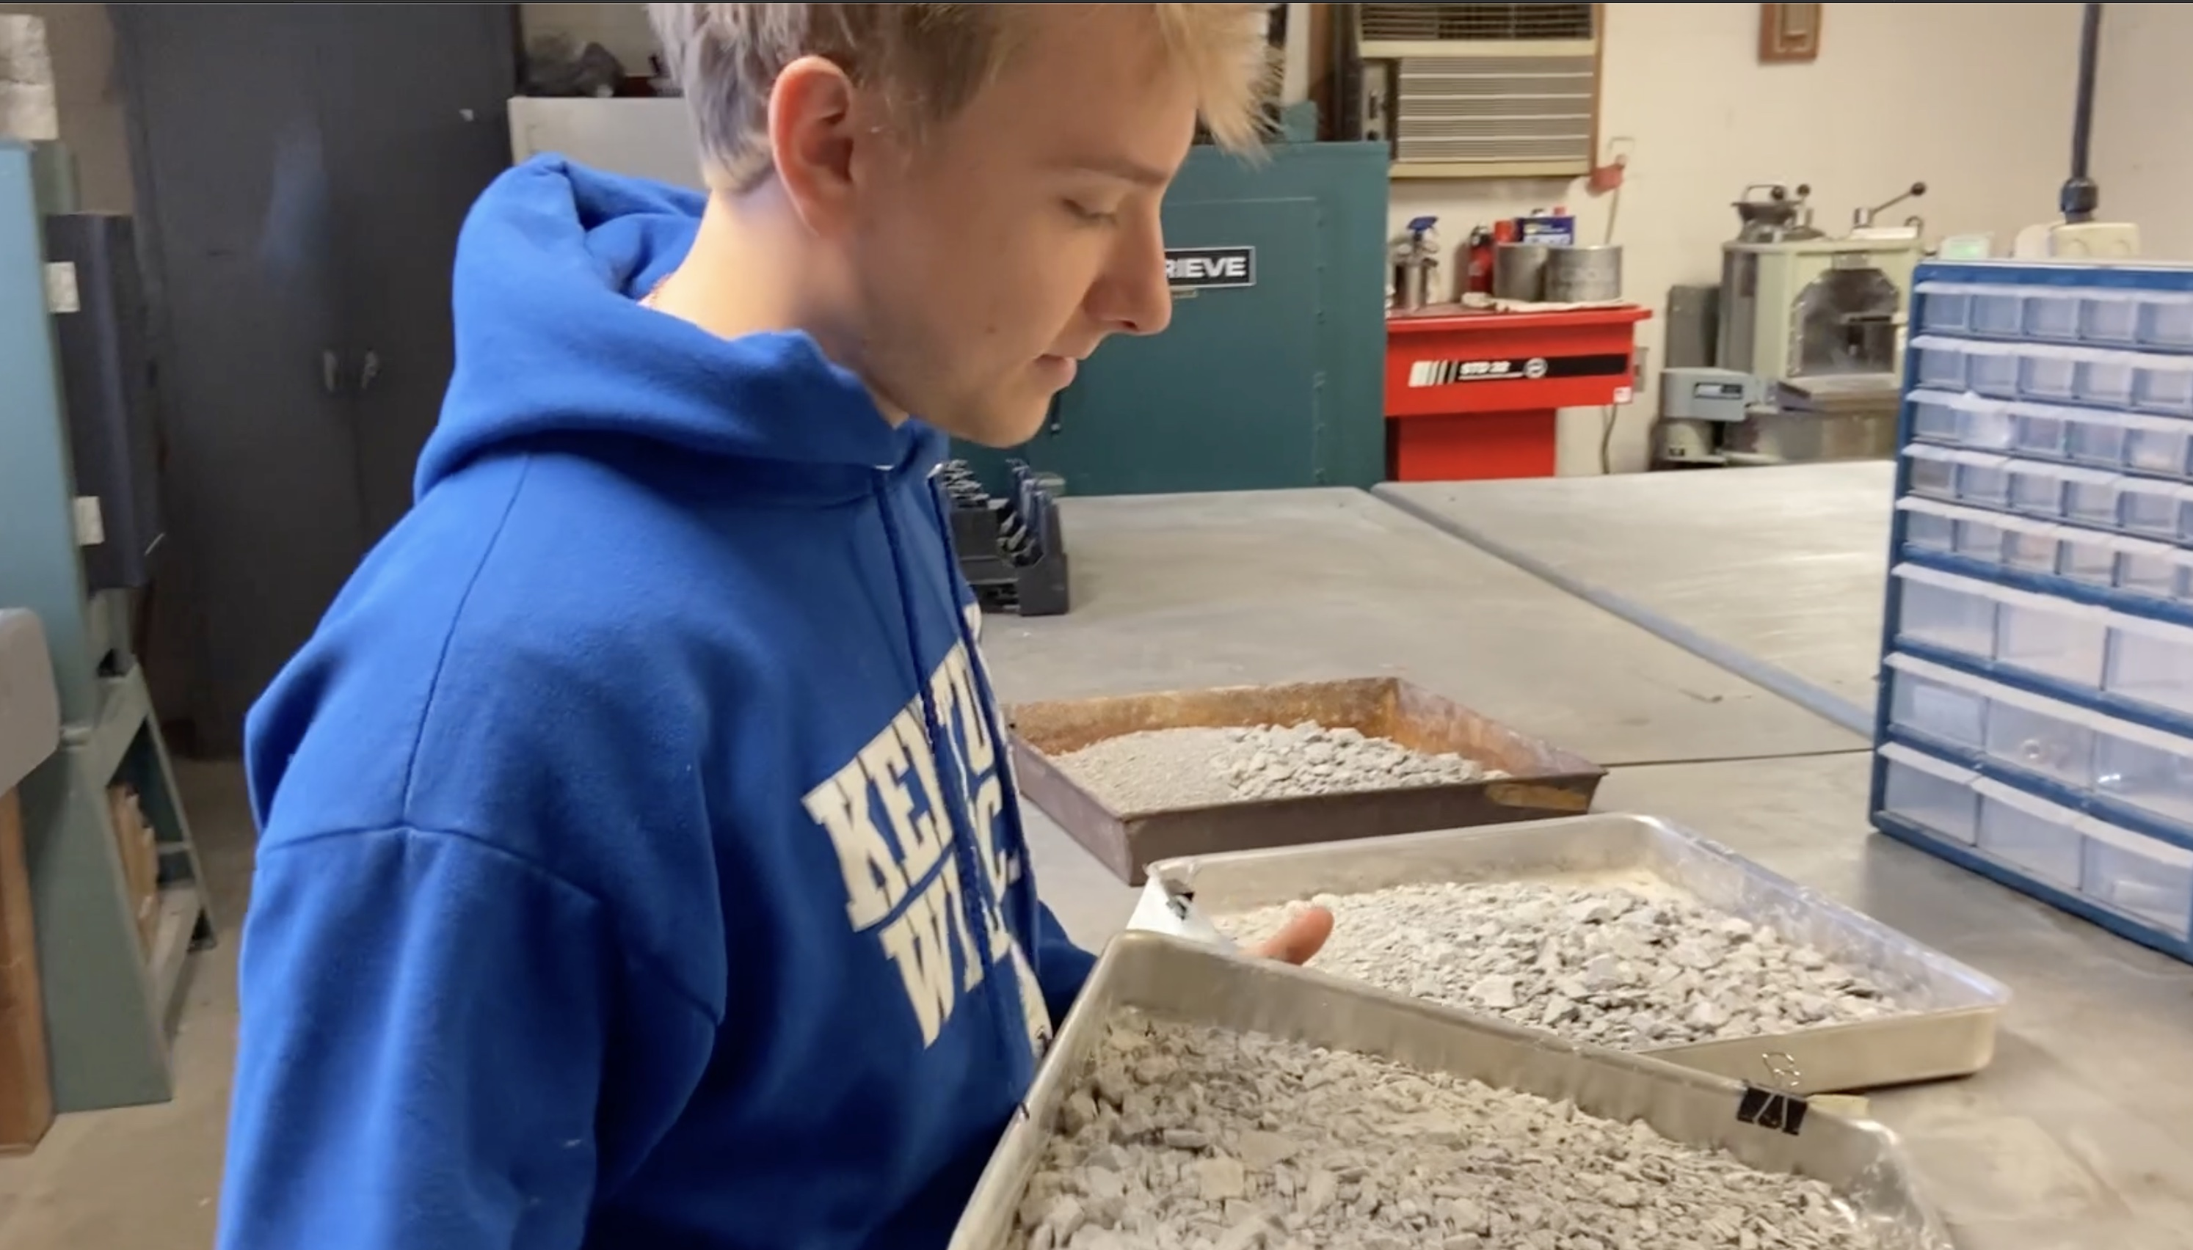
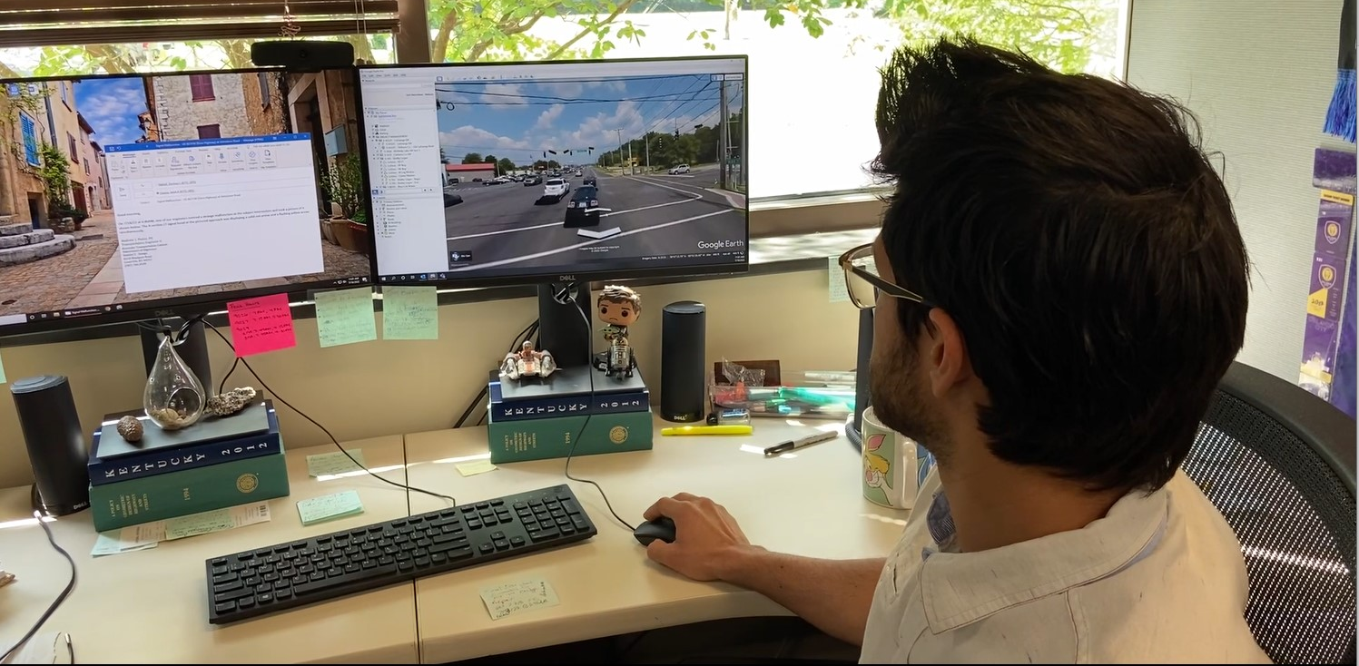
INTERNSHIPS
CO-OP AND INTERNSHIP PROGRAMS provide hands-on experience in select fields for high school seniors and college students.
MINORITY INTERNSHIP PROGRAM (MIP) provides career opportunities, formal mentoring, and hands-on experiences to traditionally under-represented groups. It is designed specifically for undergraduates and graduates of Kentucky colleges and universities.
TRANSPORTATION MECHANIC APPRENTICESHIP PROGRAM (TMAP) provides paid, practical, hands-on experience at the local level of the Department of Highways for students currently enrolled in an Automotive or Diesel Technology Program through the Kentucky Community and Technical College System (KCTCS).

Slide 13
QUESTIONS?

Slide 14
CONTACT INFORMATION
Zack Neihof, PE, RSP1
State Highway Engineer’s Office
KEEN Board Member
(502)-445-4566
Zachary.Neihof@ky.gov

